Slide 1
Taking advantage of critical thinking
Galina Sharonova
Senior Methodologist at ONARA
CELTA, Delta M2, Train the Trainer
@galina.sharonova
@onara.books

Slide 2
How to plan a critical thinking lesson?
It is usually a skills- based lesson
While planning your lesson, keep the following in mind:
Students
Aims
What exactly you want to develop
What you have (materials, aids) and if it is enough
How to adapt / supplement your materials
While conducting a lesson:
Experiment & reflect
Have no fear to make a mistake

Slide 3
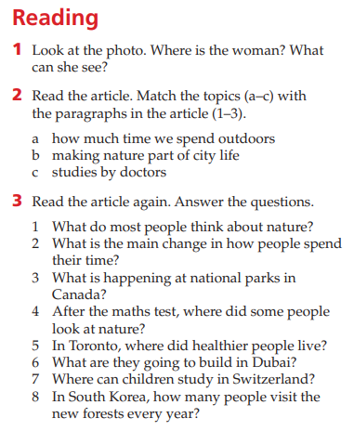
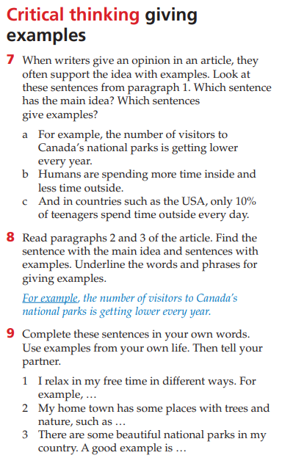
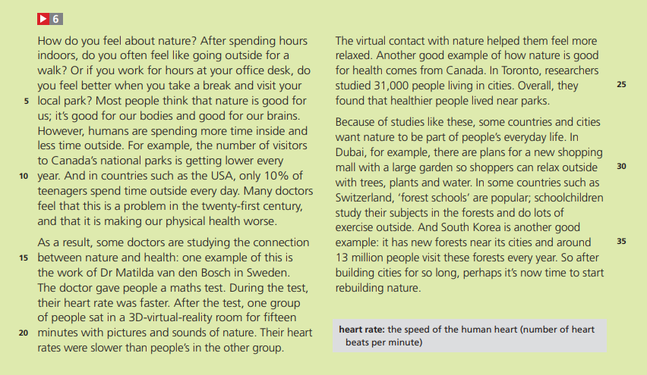
Let’s learn from some ready-made ideas
Analyse what you have
Which critical thinking strategies do you want to develop?
Is it enough?
What to add? How to adapt?
Life 2nd edition Pre-Intermediate. SB. NGL

Slide 4
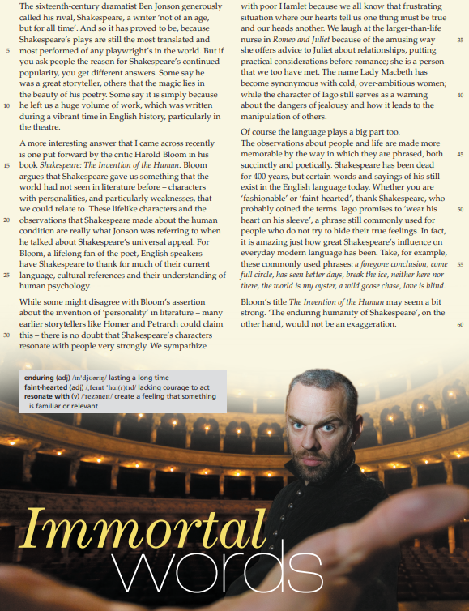
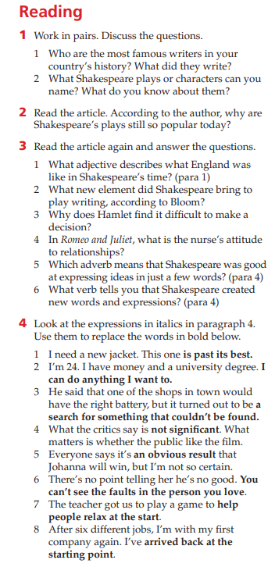
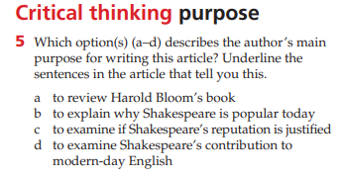
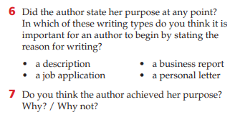
Let’s do it
Analyse what you have
Which critical thinking strategies do you want to develop?
Is it enough?
What to add? How to adapt?
Life 2nd edition Advanced. SB. NGL

Slide 5
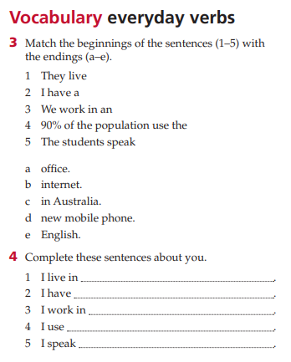
Let’s do it
Analyse what you have
Which critical thinking strategies do you want to develop?
Is it enough?
What to add? How to adapt?
Life 2nd edition Elementary. WB. NGL

Slide 6
Thank you
T: +7(495)786 87 09 (143)
Email: g.sharonova@onara.ru
arano@onara.ru
www.onara.ru
115184 г. Москва, ул. Б. Татарская, д.7

